Slide 1



Online training platform on Mobility in Guidance activities
France
Workshop
5th June 2020

Slide 2
Discover
INform
Accompany Support Mobility
Orientation
Workshop
5th June 2020

Slide 3
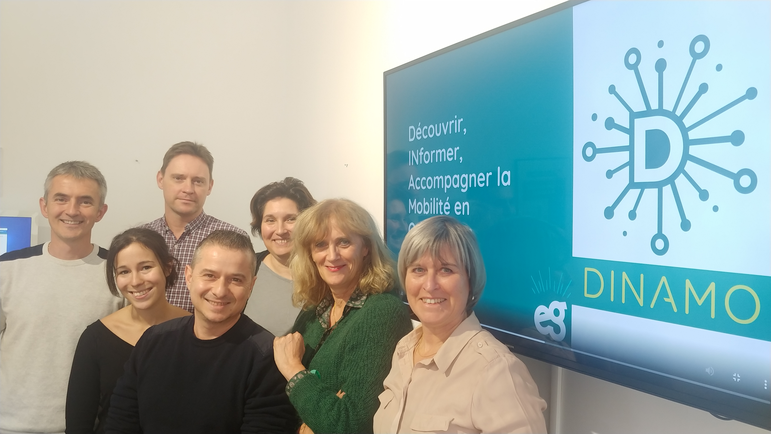
Euroguidance French team
Workshop
5th June 2020

Slide 4
Euroguidance Network
One main objective
Support the competence development of the guidance community on the European dimension of lifelong guidance.
Three main goals
Support the development of the European dimension of lifelong guidance within national guidance systems.
Support competence development of guidance practitioners and raise their awareness on the value of international mobility.
Provide Information and communication on the European dimension of guidance.

Slide 5
First poll
Have you ever trained guidance counsellors on the subject of mobility? (online or face-to-face)

Slide 6
Second poll
What are the essential criteria you are looking for in a distance learning course?

Slide 7

What is it?
An online training platform where anyone can connect for free
cooperative, self-training
A new tool for the professionalisation of professionals
www.euroguidance-formation.org

Slide 8

For whom?
Guidance professionals
LL guidance practitioners who advise on international mobility issues
Guidance professionals working in the field of mobility
Teachers
International relations staff
More than 800 subscribers since the launch in October 2019

Slide 9

How ?
For one year, we compared different technical solutions and we decided to use a Moodle platform
EG France is the owner of the platform which means :
  We can have as many participants as we want
  We can open as many modules or courses as we need

Slide 10
Small Group Discussion
7 minutes…
In your opinion, what are the most important topics to be addressed in a training for guidance professionals on mobility issues?

Slide 11
Please open a new tab and go to www.menti.com
Use the code 28 70 21

Slide 12

What content ?
The benefits of mobility
European tools for mobility
(ECTS, Erasmus+, Europass, ...)
The different kinds of mobility
Inclusive mobility
The guidance and mobility counselling

Slide 13

Learning outcomes
Evaluation of learning outcomes
Recognition by the delivery of Open Badges
  One for each module
  One for all

Slide 14
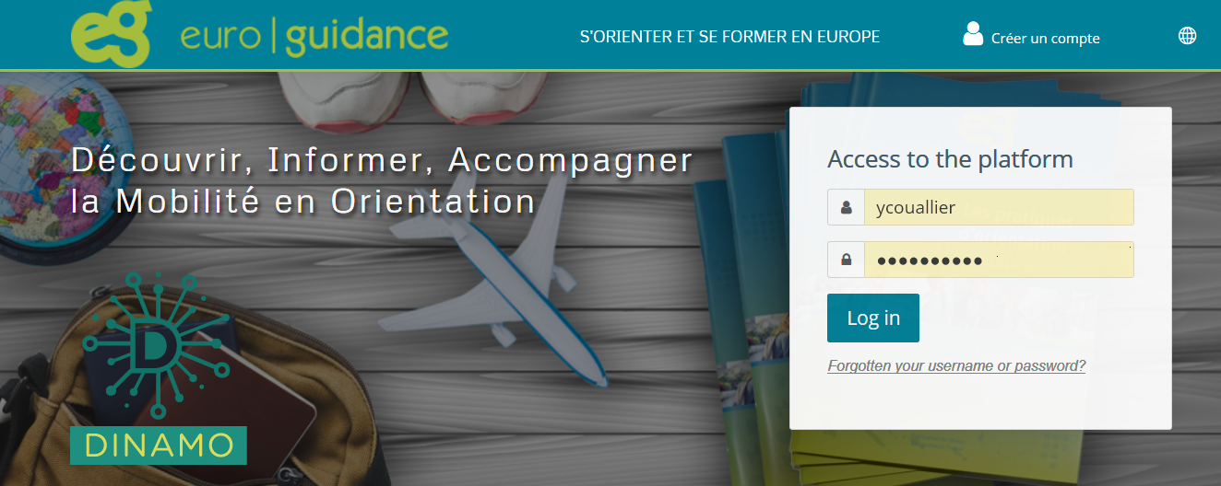
Let’s test the platform
Create an account
Choose « English »
www.euroguidance-formation.org

Slide 15
Evolution and improvement zones
Integration of some modules into the online platform of the French Ministry of Education : hybrid courses setting for teachers and guidance counsellors
Add a virtual class inside each module : webinar
Develop more topics
Transnational courses shared with French speaking EG countries
English translation possible for each module?

Slide 16

Invitation
An English translated course :
Mobility & Guidance Counselling
www.euroguidance-formation.org

Slide 17

Any questions?

Slide 18

Thank you for your participation !

